Slide 1
OcuPhysics:
Modeling E&M in Virtual Reality
Kevin Chaplin, Sherry Wang, Bernice Wu
TJHSST Computer Systems Lab
June 2016

Slide 2
Overview
Simulate concepts in electricity and magnetism
View electric field lines and charged objects using Oculus Rift
Interact with simulation using Leap Motion Controller

Slide 3
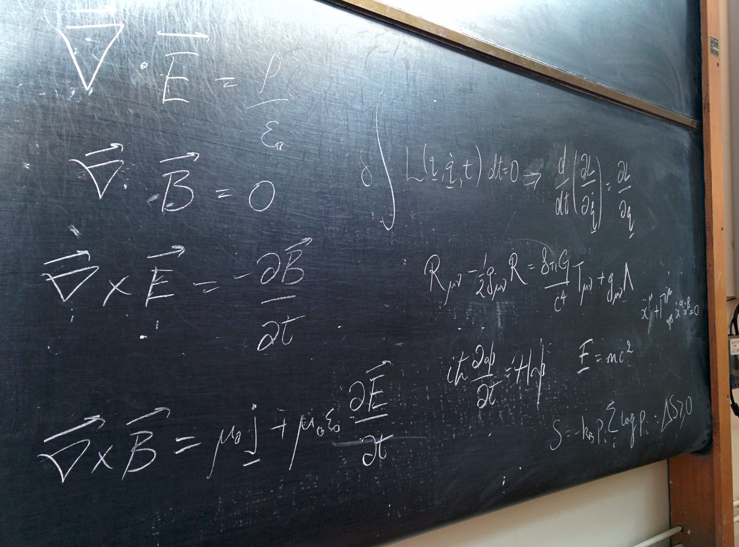
Purpose
Beginning physics students
Applications to industry
Fig 1. Traditional 2-D physics lecture.

Slide 4
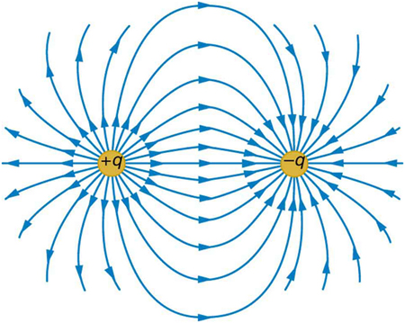
Background
Electric fields from point charges
E = kq/r²
3D vector field
Virtual reality
Oculus Rift
Leap Motion device
Fig 2. 2D representations of point charges.

Slide 5
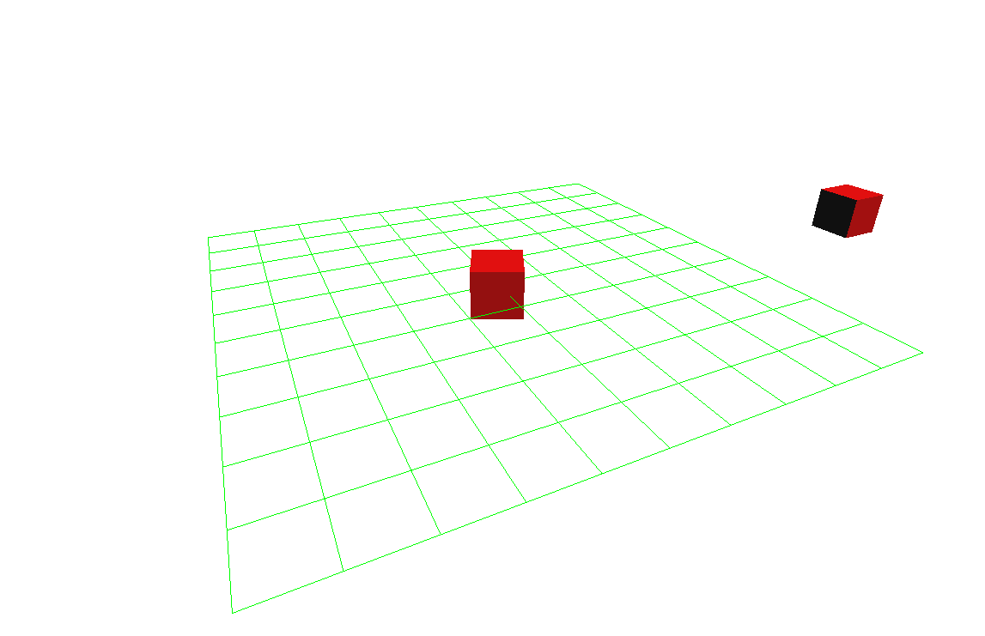
Prior Work
TJHSST Computer Systems Lab 2015 project by Le, Ly, Tsung, and Vogel
Physics engines
Three.js
Fig 3. Three.js sample

Slide 6
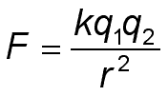
Procedure: Simulation
Coulomb’s Law
Vector representation of electric field in space

Slide 7
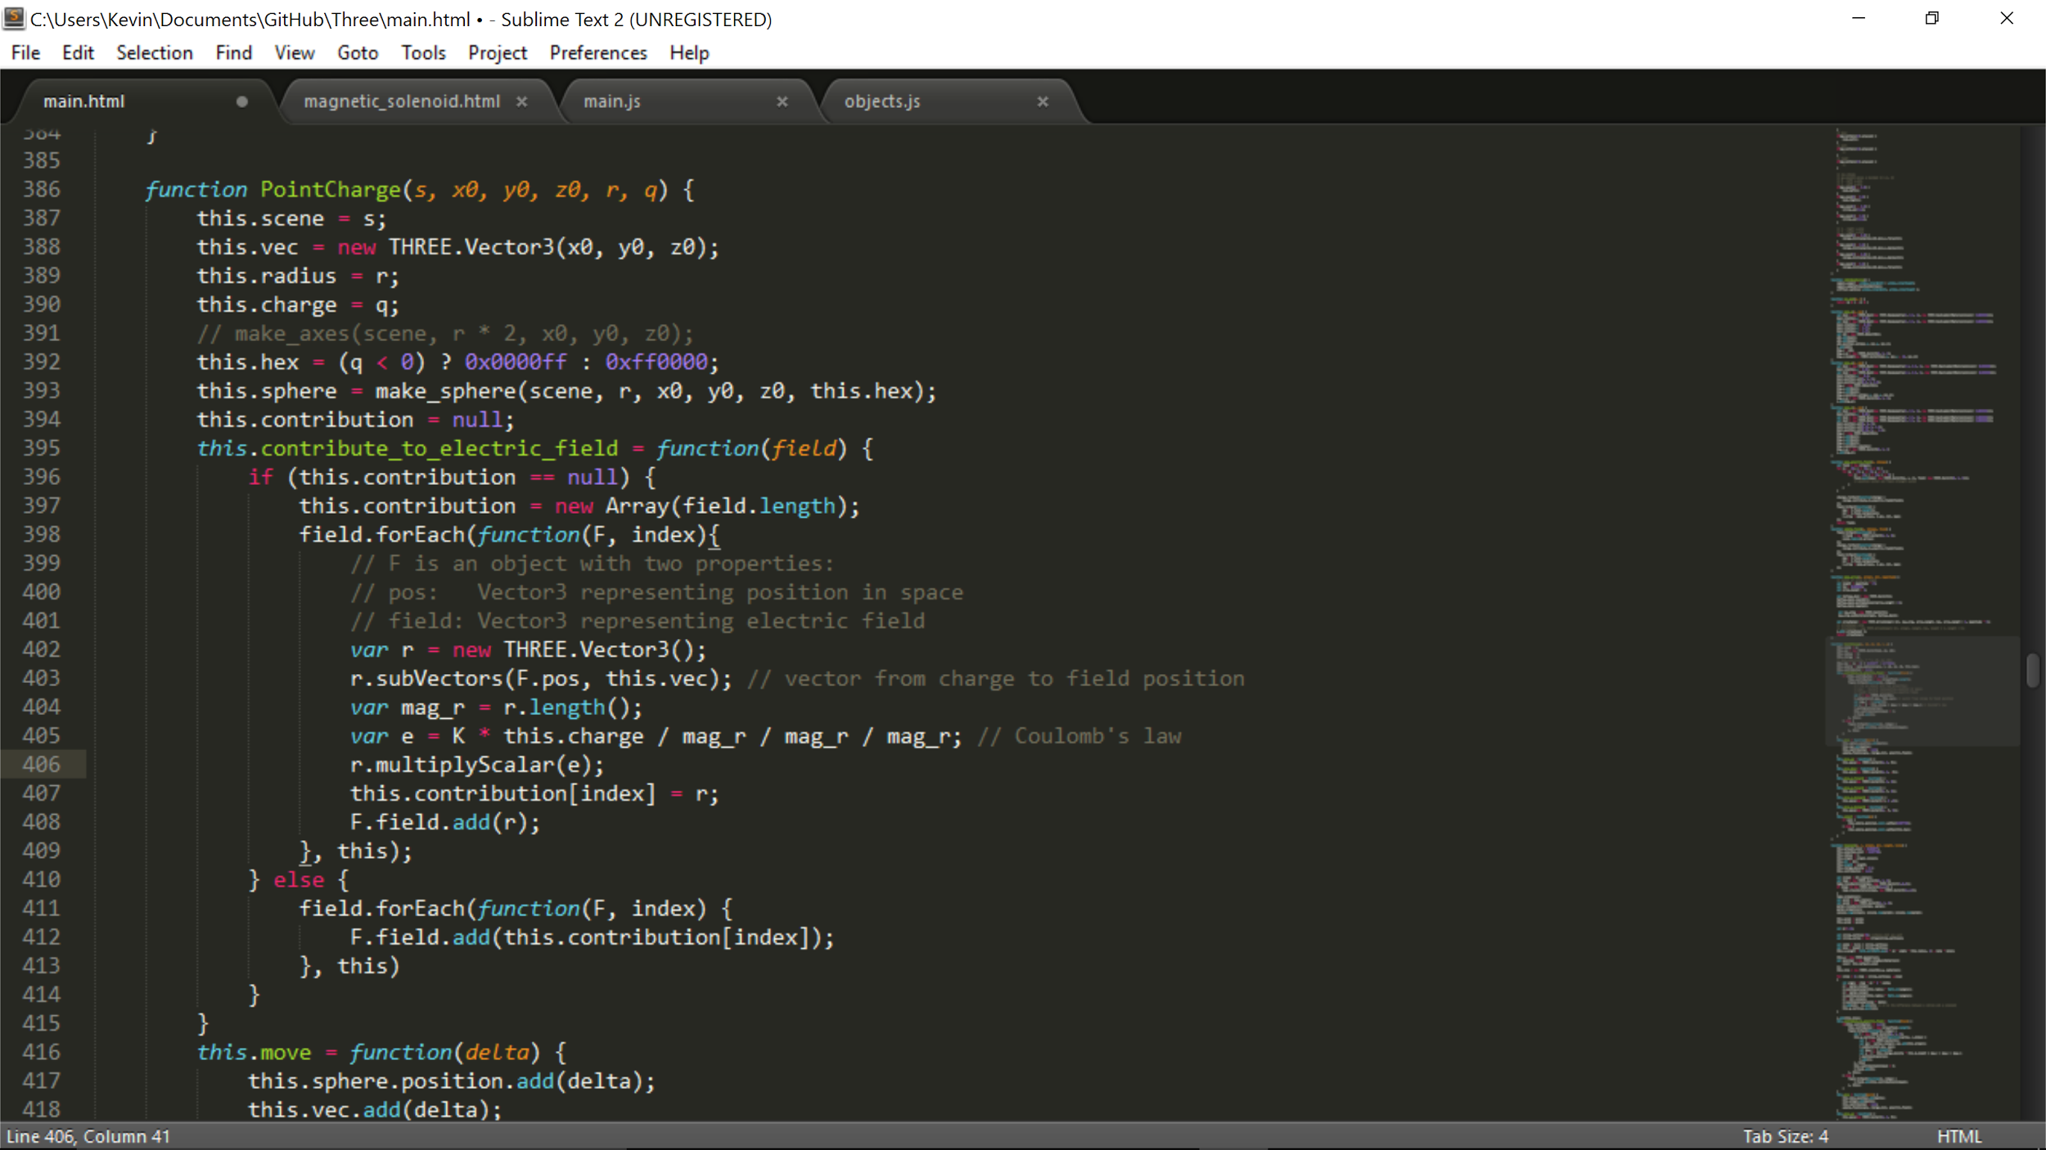
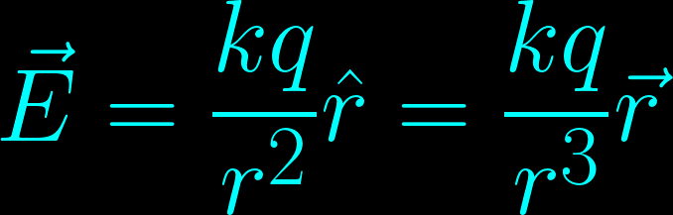
Sample Code

Slide 8
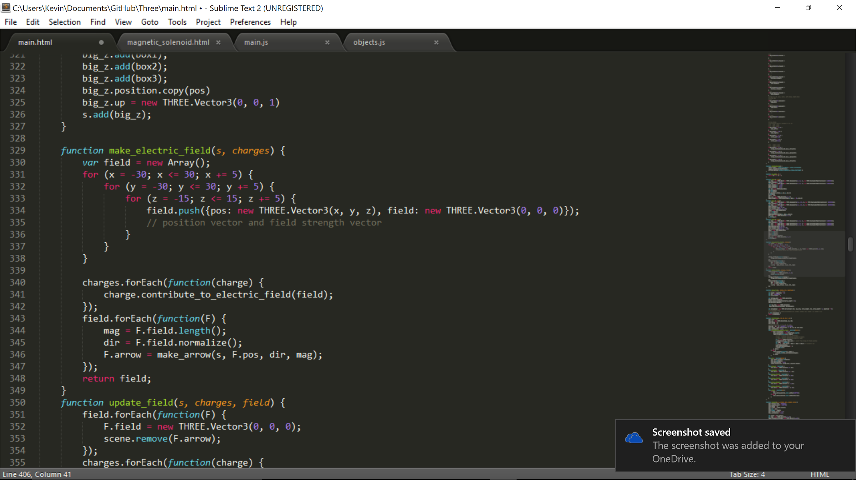

Slide 9
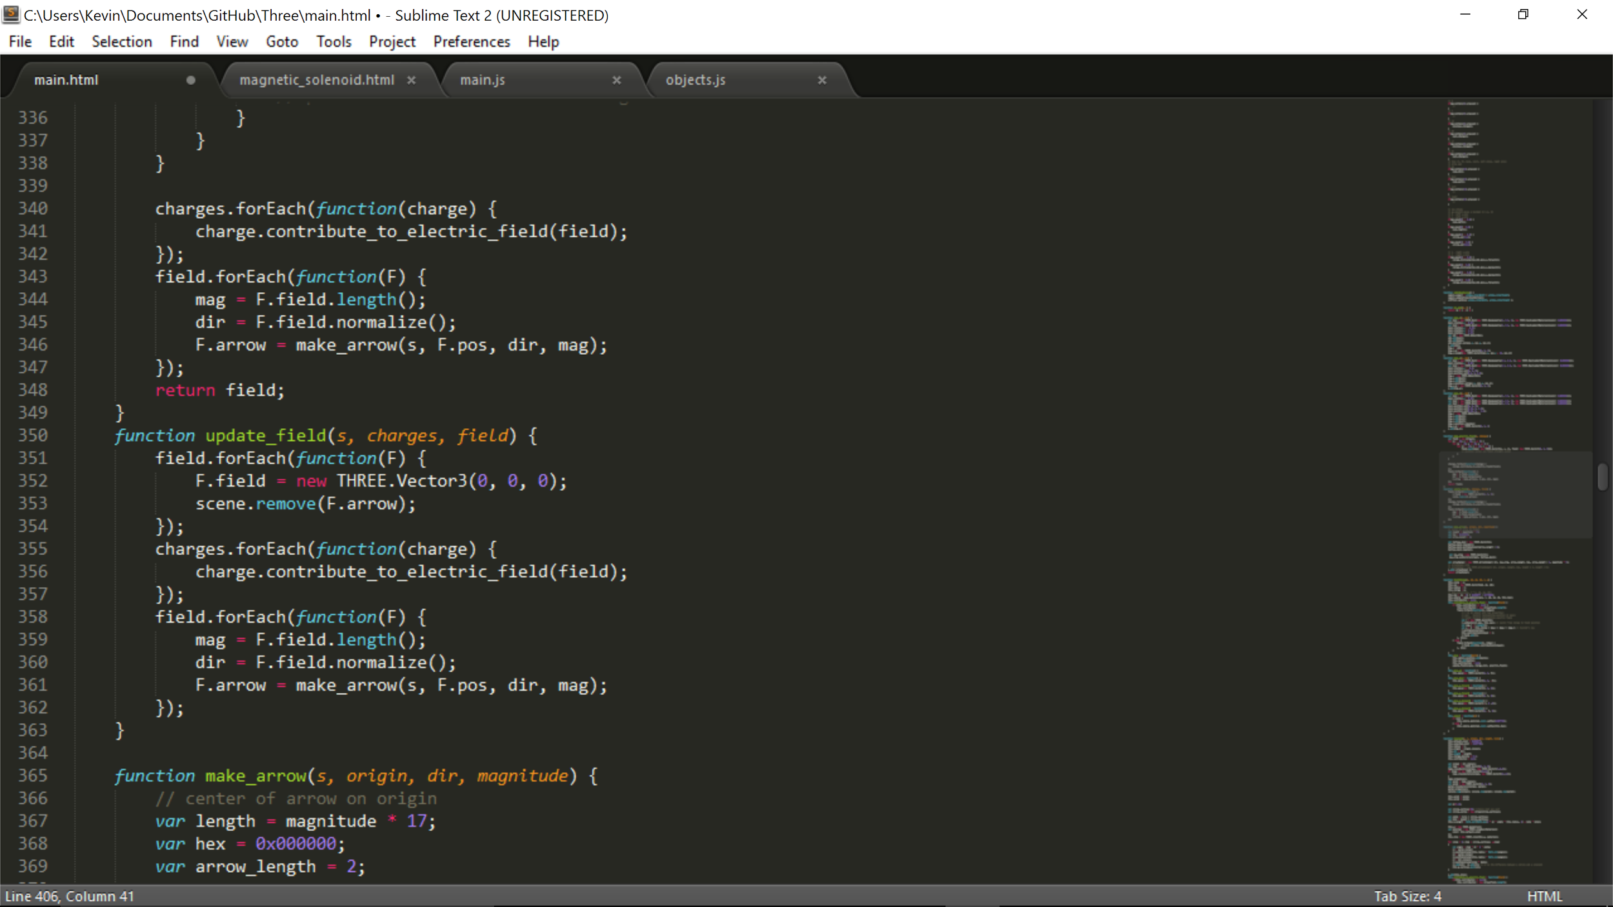

Slide 10
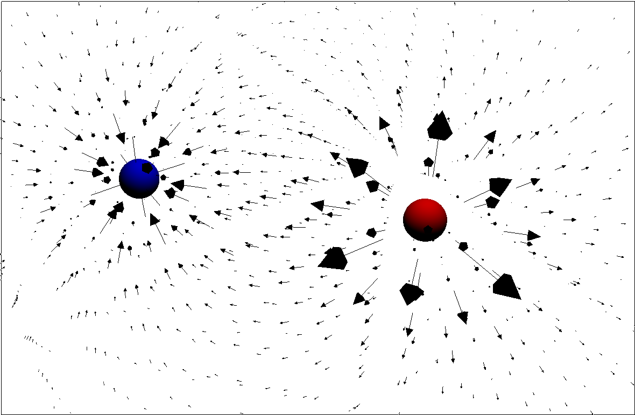
Fig 4. Sample model of the electric field between positive (red) and negative (blue) point charges.

Slide 11
Procedure: Leap Motion Controller
Gestures created by last year’s group
Include fists and pointing
Right hand pointing - select an object
Right hand pointing, left hand fist - move an object
Left hand pointing, right hand fist - restart tutorial
Fig 5. User interacting with the Leap Motion Controller and Oculus Rift.

Slide 12
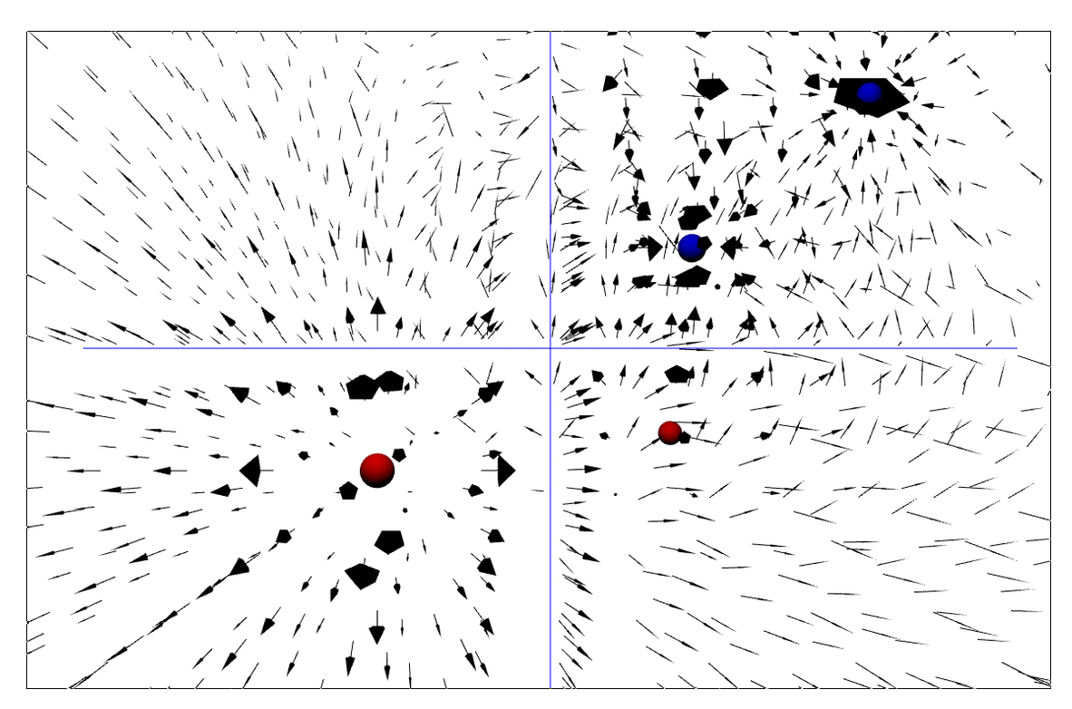
Fig 6. Example of changing electric field due to moving negative charge with axes denoted in blue.

Slide 13
Procedure: Display
Split screen for Oculus
Motion tracking built into hardware

Slide 14
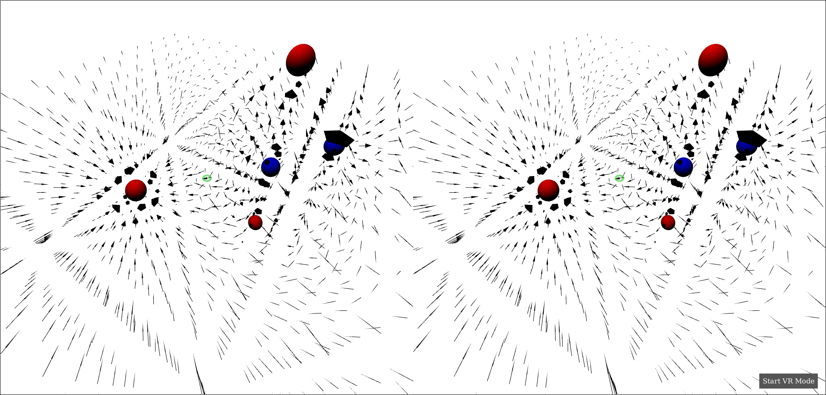
Fig 7. Sample model of the electric field in split-screen/Oculus mode with origin denoted in green.

Slide 15
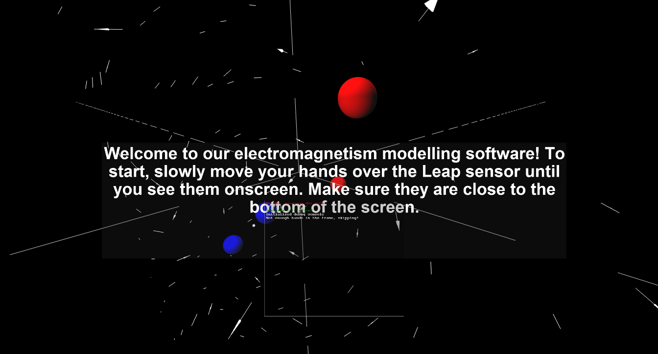

Slide 16
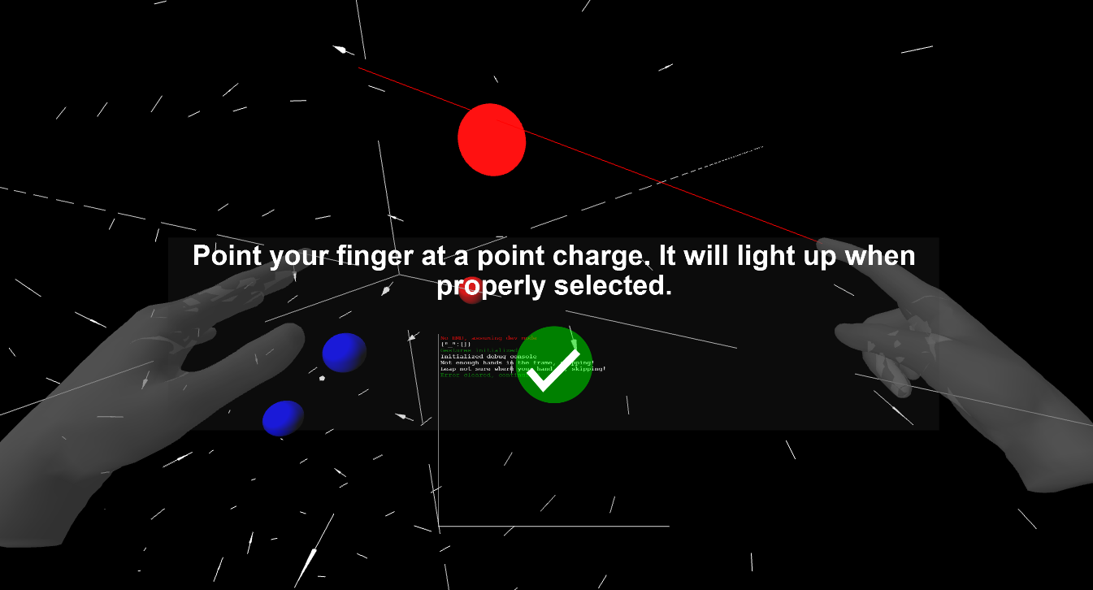

Slide 17
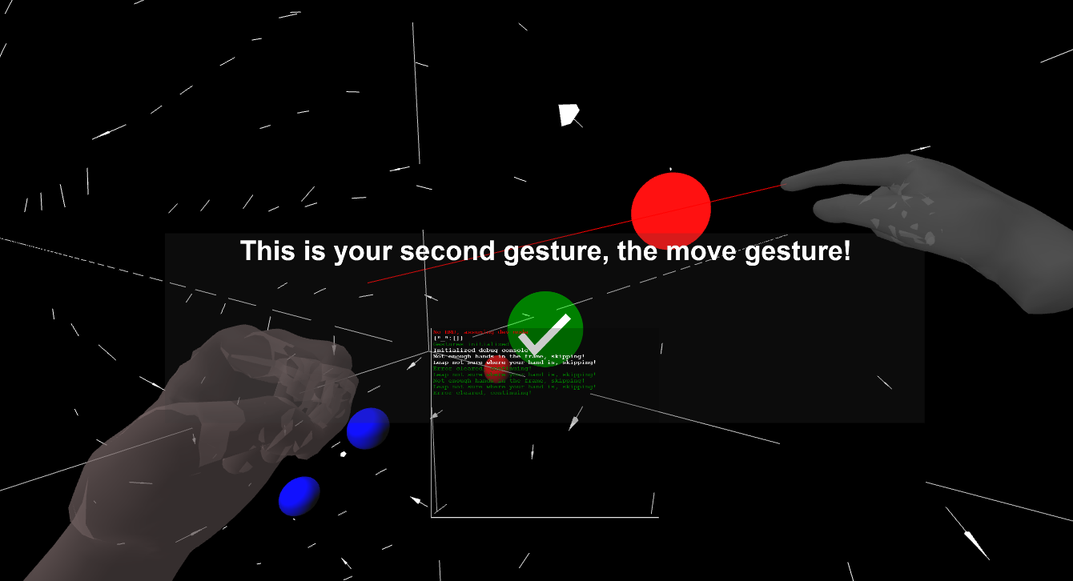

Slide 18
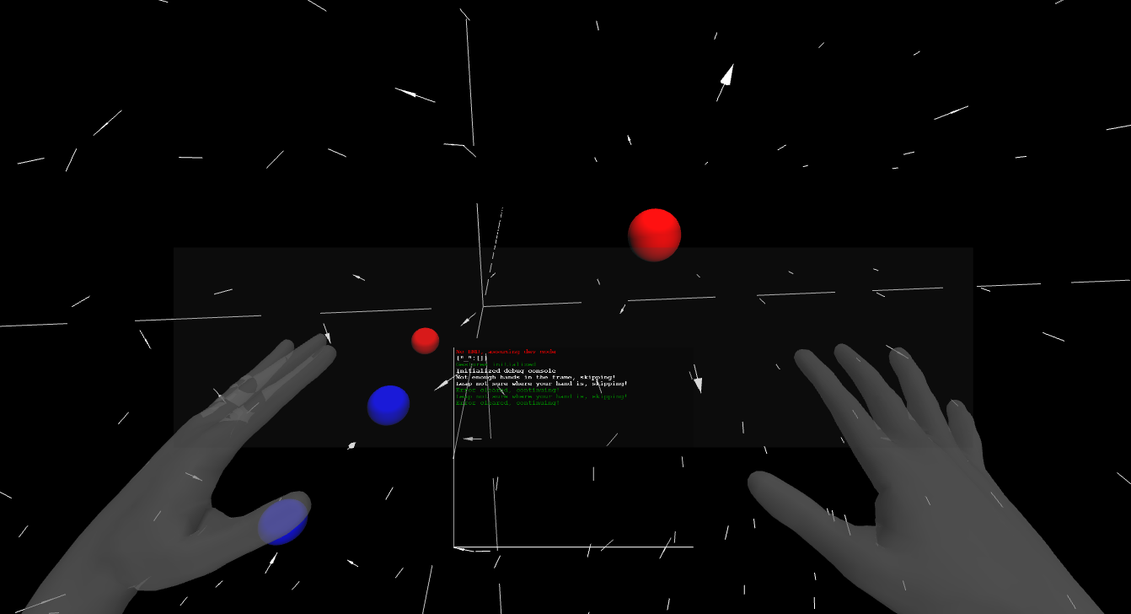

Slide 19
Conclusion
✔ Oculus
✔ Leap
✔ Point charges
✔ Electric field
✔ Modify arrangement

Slide 20
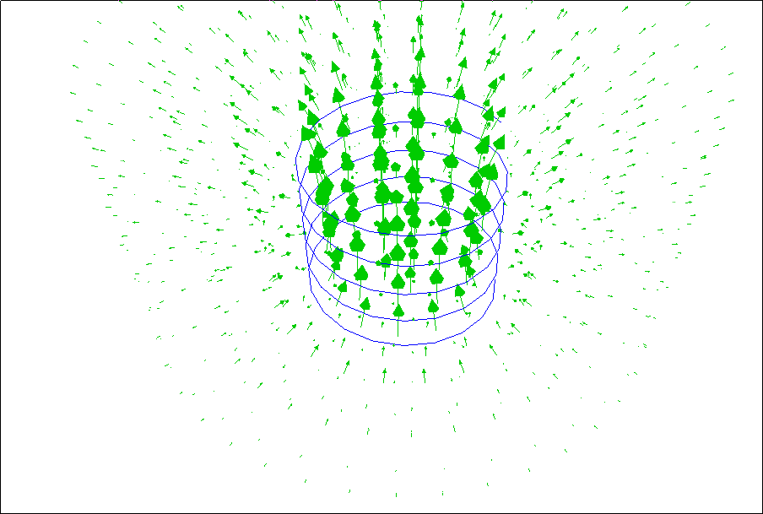
Further Research
More objects
More gestures
Magnetic fields
Change over time
Update hardware
Fig 8. Solenoid with current & magnetic field

Slide 21
Recognition
Dr. Peter Gabor
Fox Wilson
Thai Le, Austin Ly, Ellis Tsung, Jonathon Vogel
Matthew Gallagher from Code for NoVA

Slide 22
References
Chafkin, M. (2015, October). Why Facebook’s $2 Billion Bet on Oculus Rift Might One Day Connect Everyone on Earth. Vanity Fair. Retrieved from http://www.vanityfair.com/news/2015/09/oculus-rift-mark-zuckerberg-cover-story-palmer-luckey
Chordia, P. (2015, June 17). NodeJS - How to resolve “Cannot find module” error [Online forum post]. Retrieved from stackoverflow website: http://stackoverflow.com/questions/9023672/nodejs-how-to-resolve-cannot-find-module-error
npm. (2015, April 27). Fixing npm permissions. Retrieved from npmjs.com website: https://docs.npmjs.com/getting-started/fixing-npm-permissions
Oculus VR. (2016, May 2). Oculus Rift Retail Experience Kicks Off at Best Buy Locations May 7 [Blog post]. Retrieved from Oculus Blog: https://www.oculus.com/en-us/blog/oculus-rift-retail-experience-kicks-off-at-best-buy-locations-may-7/
Rubin, P. (2014, May 20). The Inside Story of Oculus Rift and How Virtual Reality Became Reality. Retrieved from Wired website: http://www.wired.com/2014/05/oculus-rift-4/
sindresorhus. (2014, October 19). Install npm packages globally without sudo on OS X and Linux. Retrieved from github website: https://github.com/sindresorhus/guides/blob/master/npm-global-without-sudo.md
three.js / documentation. (n.d.). Retrieved from http://threejs.org/docs/

